Slide 1
20th India Power Forum
22nd Nov’2017
Sustainability of Power Business; Paradigm Shift for 24x7 Power For All
Business case of Decommissioning Thermal Power Plants and their Replacement with Efficient and Cleaner Units
By
R. S. Sharma
Managing Director (Bajaj Power Ventures Ltd)
(Former CMD, NTPC)

Slide 2
Installed capacity of country as on 31st Oct’2017
Sr. No. | Sector | Capacity in MW | % age Share
1 | Total Thermal | 219414.51 | 66.26%
 | Coal | 193426.50 | 58.41%
 | Gas | 25150.38 | 7.60%
 | Oil | 837.63 | 0.25%
2 | Hydro (Renewable) | 44765.42 | 13.52%
3 | Nuclear | 6780.00 | 2.05%
4 | RES** (MNRE) | 60157.66 | 18.17%
 | Total | 331117.58 | 100%

Slide 3
Details of coal based thermal power capacities
Range | No of Units | MW | %
Upto 110 MW | 107 | 8241.5 | 4.3
>110 MW & <200 MW | 61 | 8252 | 4.3
200/ 210/ 250/270MW | 228 | 50680 | 26.3
>270 MW & <490 MW | 42 | 12900 | 6.7
490 MW to 800 MW | 193 | 112300 | 58.4
Total | 631 | 192373.5* | 100
* The figures are based on Aug’2017 data

Slide 4
Existing design heat rate Vs normative heat rate comparison
Range | Present Design Turbine Heat rate K Cal/ KWH | Operating GSHR with 4.5% margin (boiler eff 86%) | Normative GSHR K Cal/ KWH | Difference in K Cal/ KWH | Operating thermal eff %
Upto 60 MW | 2309 | 2805 | 2900 | 95 | 29.65
110 MW | 2175 | 2643 | 2750 | 107 | 31.3
200/ 210/250 MW | 1960-1980 | 2382 – 2406 | 2450-2500 | 44 – 68 | 34.4
500/600 MW Sub Critical | 1940-1950 | 2357 – 2369 | 2375-2425 | 6 – 18 | 35.5
660 MW Super critical | 1830-1860 | 2224 – 2260 | 2258 | 0 - 34 | 38.1
800 MW Super Critical | 1777 -1829 | 2086 – 2148 Boiler eff 89% | ---- |  | >40

Slide 5
Latest available design heat rate Vs normative heat rate comparison
Range | Latest Design Turbine Heat rate K Cal/ KWH | Operating GSHR with 4.5% margin (boiler eff 86%) | Normative GSHR K Cal/ KWH | Difference in K Cal/ KWH | Operating Thermal efficiency %
110 MW | 1960 | 2382 | 2750 | 368 | 36.1
200/ 210/250 MW | 1875 | 2278 | 2450 | 172 | 37.7
500/600 MW Sub Critical | 1860 | 2260 | 2375 | 115 | 38.1
660 MW Super critical | 1818 | 2209 | 2258 | 49 | 38.9
Ultra Super critical | 1760 | 2066 Boiler eff. 89% | ----

Slide 6
Margin of Improvement of thermal efficiency
Range | Operating GSHR with 4.5% margin (boiler eff 86%) | Latest calculated GSHR with 4.5% margin (boiler eff 86%) | Scope of Improvement K Cal/KWH | Scope of improvement in thermal efficiency %
110 MW | 2643 | 2382 | 261 | 3.6
200/ 210/250 MW | 2382 – 2406 | 2278 | 128 | 2.0
500/600 MW Sub Critical | 2357 – 2369 | 2260 | 109 | 1.8
660 MW Super critical | 2224 – 2260 | 2209 | 51 | 0.9

Slide 7
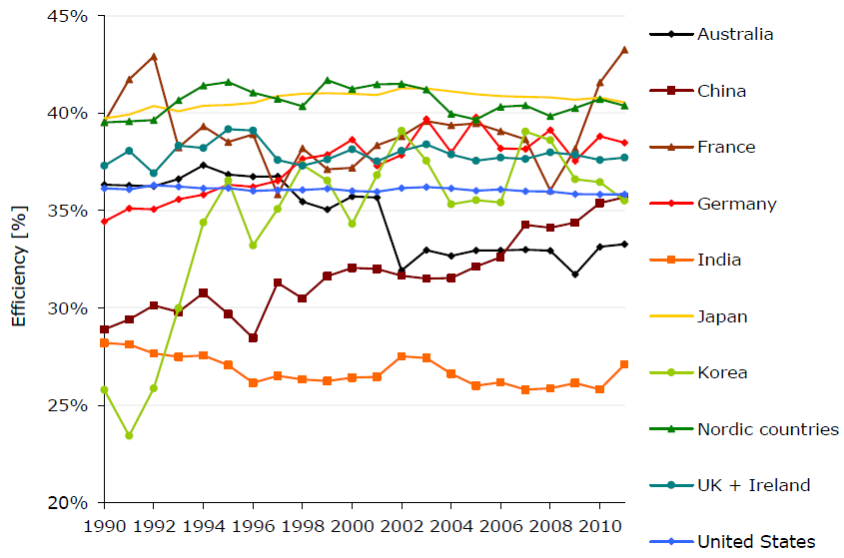
Comparison of coal based thermal efficiency
Note: From 2012 to 2014 the average efficiency has improved to above 30%
Ref: Ecofys report-2014.

Slide 8
Potential of improvements in plant efficiency in APEC countries
Category | Area of improvement | Net efficiency gain (% points)
Combustion system | Pulveriser and feeder upgrades | 0.30
 | Air heater repair or upgrade | 0.25
 | Soot blower improvements | 0.35
 | Excess air I&C | 0.20
Steam cycle | Feed water heater repairs | 0.40
 | Heat transfer tube upgrades | 0.60
 | Steam turbine blades, sealings | 0.50
 | Cycle isolation | 0.50
 | Condenser repairs | 0.40
O&M | O&M training
 | Computerized maintenance and management systems and reliability centred maintenance. | Included in combustion and steam cycle gains. Efficient operation realised over the long term.
 | Distributed control systems
Combined total |  | 3.50
Ref: (Boncimino and others, 2005) IEA , Nov’2015

Slide 9
Decommissioning
Vs
efficiency improvement in existing capacities

Slide 10
Case-1: With super critical parameters and unit size 660 MW (replacement of 3 units of 200/210 MW)
Description | UOM | Present | New | Percentage improvement
THR | kcal/kWh | 2050 | 1818 | 11.32
Boiler efficiency | % | 85 | 86 | 1.17
GSHR | kcal/kWh | 2520 | 2209 | 12.35
Aux Power Consump | % | 9 | 6.75 | 25
NSHR | kcal/kWh | 2770 | 2369 | 14.46
Comparison of cost of generation
Description | UOM | Present | New | Difference
FC | Rs | 0.66 | 2.30 | (1.64)
VC | Rs | 2.25 | 1.92 | 0.33
Total Cost | Rs | 2.91 | 4.22 | (1.31)
Note: The cost of generation will substantially increase.
If unit runs in subcritical parameters, the generation cost shall further increase.

Slide 11
Case-2: Expected benefits by improving a 210 MW unit
Description | UOM | Pre R&M | After R&M (target) | Percentage improvement
THR | kcal/kWh | 2050 | 1875 | 8.54
Boiler efficiency | % | 85 | 86 | 1.17
GSHR | kcal/kWh | 2520 | 2278 | 9.60
Aux Power Consump | % | 9 | 8.5 | 5.55
NSHR | kcal/kWh | 2770 | 2490 | 10.09
Presently efficient turbines are available with 1875 THR without change in boiler’s steam parameters.
This results in reduction of Net SHR by by about 280 counts.
Cost of generation
Description | UOM | Present | New | Difference
FC | Rs | 0.66 | 0.93 | (0.27)
VC | Rs | 2.25 | 2.02 | 0.23
Total Cost | Rs | 2.91 | 2.95 | (0.04)
The renovation cost per MW with turbine R&M taken as Rs 1 Crore/MW.
With this the total cost of generation is expected to rise by Rs 0.04/KWH

Slide 13
Actionable points for improving thermal efficiency of plant
HP, IP and LP turbine retrofits, using modern 3-D blading, new control valves.
Installation of new control systems (need changing every 10 years).
New burner management systems.
Air Pre Heater improvements (sealing, additional sectors).
Upgrading of mills to reach rated/ increase capacity.
ESP improvements to reduce energy use and improved collection efficiency.
High pressure feed water heater‘s improvements.
Condenser improvements.

Slide 14
Conclusion
Selective decommissioning is OK. Non reheat design units those have completed useful life be decommissioned.
No decommissioning of 200 MW sets unless the same is non reheat with lower main steam parameters.
26% of installed capacity (50680 MW) consists of 200/210/250/270 MW. More than 50% of these are older units which are operating at higher heat rate.
For efficiency improvement 200 MW sets stand to be major candidates and target THR should be 1875.
For fixing of bottom line of thermal efficiency parameters of units a national level debate may be organized on achievable thermal efficiency of coal based plant based on national/ international data benchmarking.
National average plant efficiency to be targeted above 37% from present level of 32-33%
Continue. . . .

Slide 15
No capacity addition in place of decommissioned capacities requires to be undertaken.
Rather efforts to be primarily focused on increasing the PLF from existing 60% to 80%/ 85%. This, by itself, will marginally improve the operating efficiency of thermal power plants and also unleash enough more MWs within current installed capacity to offset any demand of fresh capacity addition for at least next 5 yrs.
Any new capacity addition in future be considered only within 100 kms distance of pit head/ costal locations.
------------------

Slide 16
Thank you

